Slide 1
Paraphrase Generation
Dong Li
lidong@whu.edu.cn
2018-5-3

Slide 2
1
Introduction

Slide 3
Introduction
What is paraphrases ?
Texts that convey the same meaning but with different expressions
What is paraphrases generation ?
Creating a paraphrase (or paraphrases) given a sentence
Paraphrases & QA
Questions
(same meaning)
Answer
Who created Microsoft?
Who started Microsoft?
Relation
Paul Allen
&
Bill Gates
<founder>

Slide 4
Introduction
Related work
Paraphrasing to match natural language and logical forms in the context of semantic parsing
Template-based method ( Berant and Liang ,2014)
Using paraphrases in the context of neural question answering models
neural question answering models (Bordes et al., 2014a,b; Dong et al., 2015)
Using paraphrases directly
Rule-based machine translation (Duboue and Chu-Carroll, 2006),
Lexical and phrasal rules from the Paraphrase Database (Narayan et al., 2016),
Rules mined from Wiktionary (Chen et al., 2016),
Rules mined from large-scale paraphrase corpora (Fader et al., 2013)
Notes:
第一个应用复述来匹配语义分析语境中的自然语言和逻辑形式

Slide 5
Introduction
Challenges
Automatically generating accurate and diverse paraphrases for a given sentence
The definition of the evaluation measure

Slide 6
2
Model

Slide 7
Learning to Paraphrase for Question Answering
EMNLP 2017

Slide 8
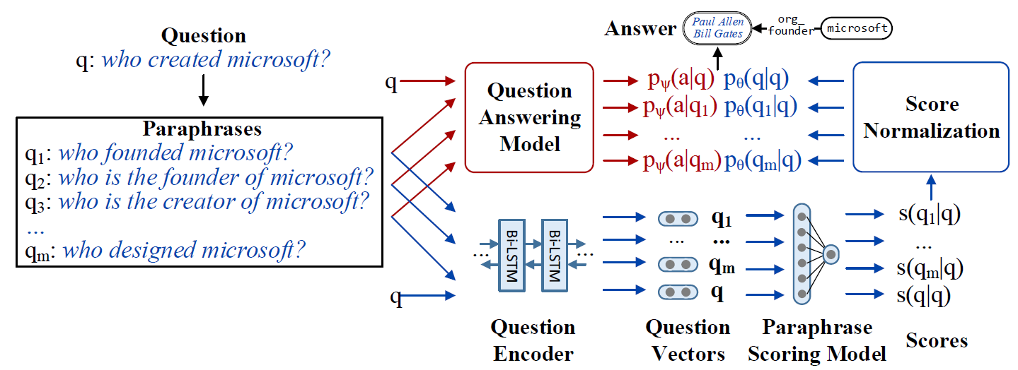
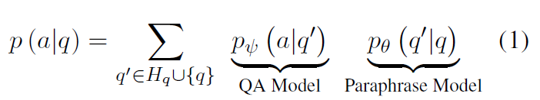

Model
：Candidate paraphrases for
Notes:
端到端的训练模型，采用问题答案对作为监督信号。
特点：灵活，不依赖于某一个复述或QA模型。
因此，可以为不同的QA任务学习不同的复述，可以为不同的应用开发适用的转述模型

Slide 9
Problem Formulation
Paraphrase Generation (1)
Three methods based on :
Lexical and phrasal rules from the Paraphrase Database (Pavlick et al., 2015)
Neural machine translation models (Sutskever et al., 2014; Bahdanau et al., 2015)
Paraphrase rules mined from clusters of related questions (Fader et al., 2014)
Notes:
理想情况，希望生成所有关于q的转述，但事实上，我们限制了候选转述的数量。
为了提升转述的覆盖范围和多样性，提出了三种方法

Slide 10
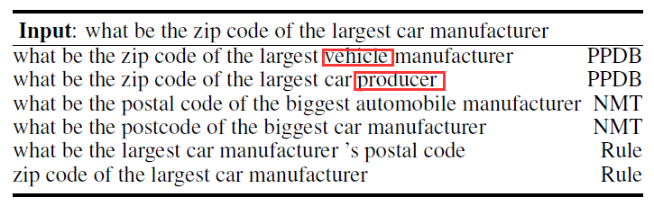
Problem Formulation
Paraphrase Generation (1)
PPDB-based Generation
Lexical and phrasal rules from the Paraphrase Database
Bilingual pivoting (Bannard and Callison-Burch, 2005)
Supervised model (Pavlick et al., 2015)
Bidirectionally entailing rules from PPDB (our method)
PPDB: a large-scale paraphrase database containing over a billion of paraphrase pairs in 24 different languages
Notes:
双语旋转，采用双语平行语料库，基于来自基于短语SMT的技术，学习生成转述；
2015年，基于自然逻辑，采用监督模型自动标注具有蕴含关系的复述对。
采用单个词或词组的规则，替换

Slide 11
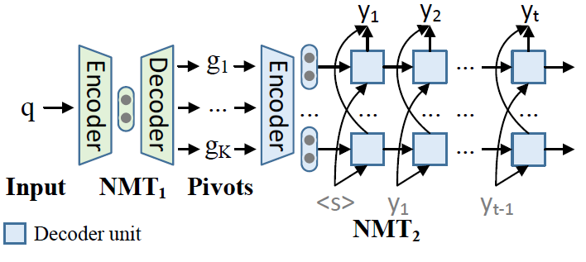
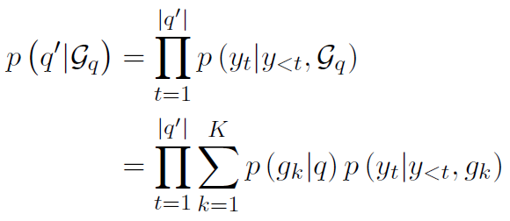

Problem Formulation
Paraphrase Generation (2)
NMT-based Generation
Neural machine translation models
Back-translation (Mallinson et al. 2016)
Syntax-agnostic
Notes:
multiple pivot sentences
语法无关性
优点：能够学习连续的表达，在复述时，能够关注到上下文

Slide 12
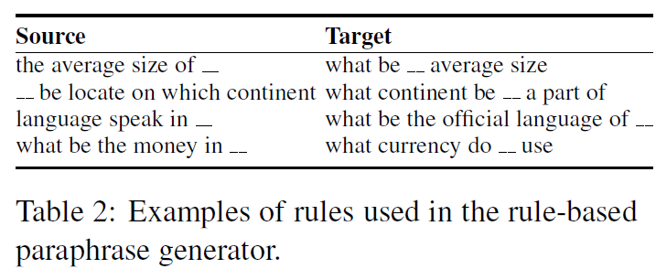
Problem Formulation
Paraphrase Generation (3)
Rule-Based Generation
Rules mined from the WikiAnswers corpus (Fader et al., 2014)
WikiAnswers corpus : more than 30 million question clusters labeled as paraphrases by WikiAnswers users
Notes:
wikiAnswer语料库，包含3千万条由人工标注为paraphrase的问题集，规模较大，
由于产生噪音的原因，45％的问题对只是相关而不是真正的复述。
首先提取问题模板（即至多一个通配符）出现在至少十个集群
然后，在同一个集群里，任意两个问题模板共同出现（5次以上），具有相同的参数，互为复述

Slide 13
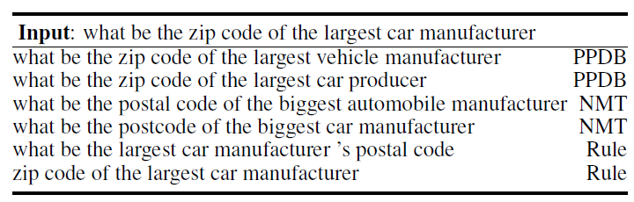
Problem Formulation
Paraphrase Generation (3)
Rule-Based Generation
Rules mined from the WikiAnswers corpus (Fader et al., 2014)
Notes:
wikiAnswer语料库，包含3千万条由人工标注为paraphrase的问题集，规模较大，
由于产生噪音的原因，45％的问题对只是相关而不是真正的复述。
首先提取问题模板（即至多一个通配符）出现在至少十个集群
然后，在同一个集群里，任意两个问题模板共同出现（5次以上），具有相同的参数，互为复述

Slide 14

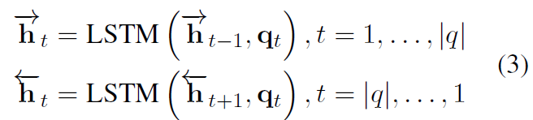

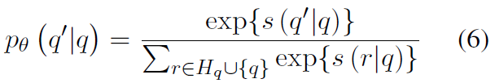
Problem Formulation
Paraphrase Scoring
Encoding: BiLSTM
Scoring:
Input:
Normalization:

Slide 15
Problem Formulation
QA Models
Knowledge Base QA
Answer Sentence Selection
Simple-graph model ( Reddy et al. 2016, 2017)
BiLSTM
Extracting features for pairs of questions and Freebase subgraphs
Using a logistic regression classifier to predict correct answer
Notes:
任务1：基于freebase知识库来回答问题
任务2：从给定的问题和有关的答案中，找出正确答案

Slide 16
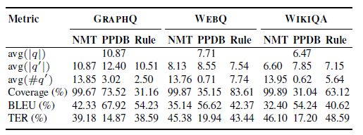
Experiments
Datasets
Notes:
graphQ: 采用人工注释方式，生成500个图谱query.包括5166个问题答案对。
webQ: 问题来自google search API ，答案是采用freebase作为后台知识库众包得到。
结构化知识库，3778条训练实例，2032条测试实例。
3. wikiQA: 来自必应搜索日志

Slide 17
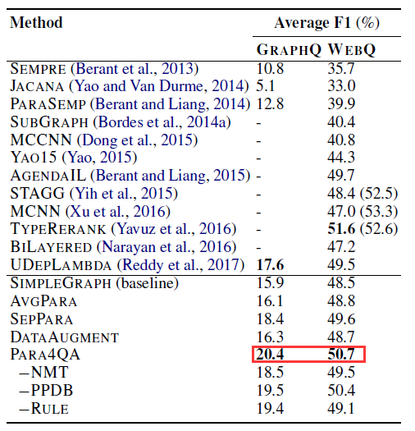
Experiments
Results(1)

Slide 18
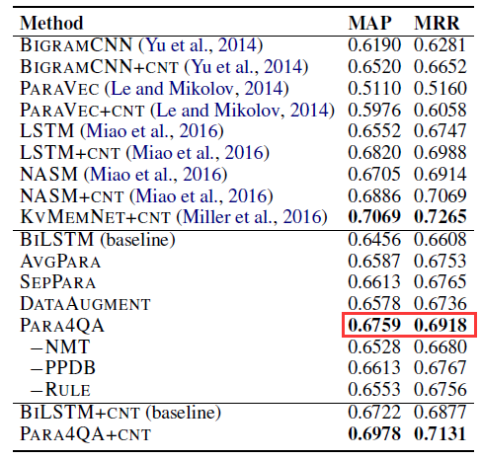
Experiments
Results(2)
Notes:
WIKIQA.实验结果
+CNT:词匹配特征

Slide 19
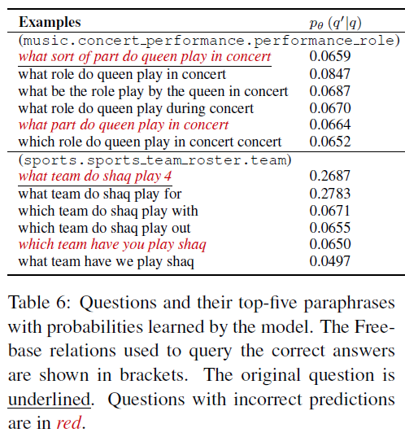
Experiments
Results(3)

Slide 20
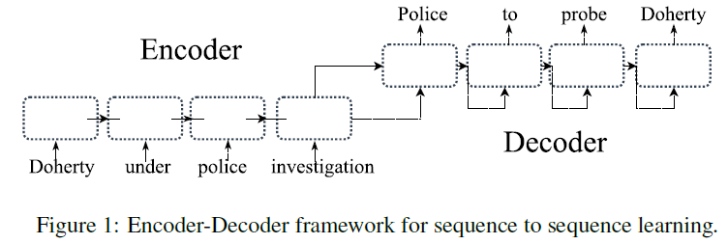
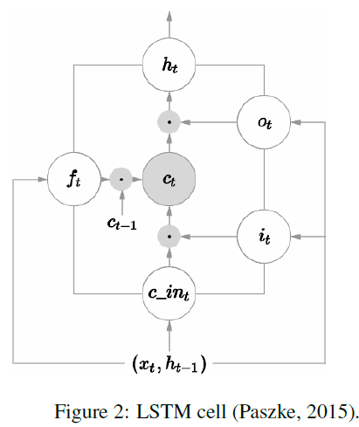
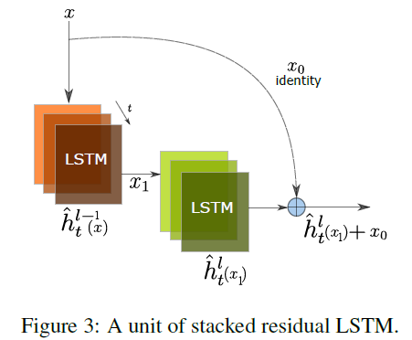
Other models
Stacked Residual LSTM networks (2016)
Notes:
第一篇用DL模型解决复述生成问题。
利用基本seq2seq 的encoder-decoder模型，采用多层结构，在层与层之间加入一个残差，来改善多层网络存在的梯度消失问题。

Slide 21
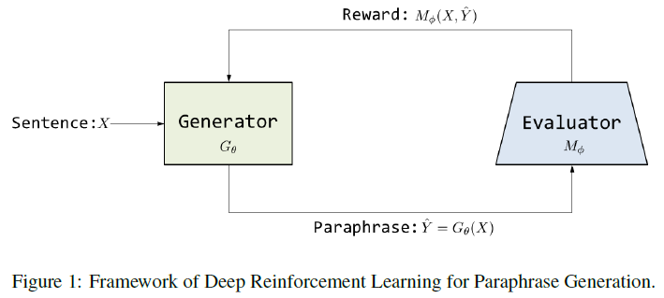
Other models
Deep Reinforcement Learning (2017)
Notes:
生成器：复述生成
s2s+copy+attention
评价器：复述识别
deep match model(decomposable attention model)

Slide 22
3
Future work

Slide 23
Future work
Research Work:
Paraphrase generation on Chinese datasets
Paraphrase & MRC
Generating accurate and diverse paraphrases

Slide 24
THANKS
2018-5-3

